Slide 1
Management of STEMI
Dr Muzammil Musthafa

Slide 2
ACS
Spectrum of conditions
Abrupt reduction in blood flow through the coronary circulation
Myocardial ischemia or infarction
NSTEACS
STEMI

Slide 3
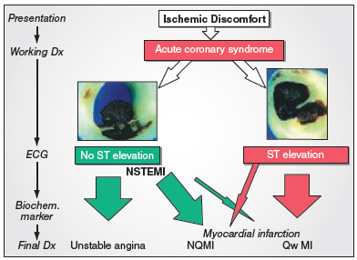

Slide 4
Worldwide, IHD – MC cause of death
1.8M annual deaths
20% of all deaths in Europe
STEMI-more common
younger > older
Men > women
Several studies highlighted fall in short term and long term mortality with use of reperfusion therapy,PCI,antithrombotic & secondary prevention
Still mortality high 4-12%

Slide 5
AMI
defined as an elevation of cardiac troponin values with necrosis in a setting consistent with myocardial ischaemia.
For treatment strategies , it is usual to designate patients with persistent chest discomfort or other symptoms suggestive of ischaemia and ST-segment changes.

Slide 6
STEMI(universal definition)
In the absence of LVH or LBBB
J point greater than 0.1mv in 2 contiguous leads other than V2-V3,where the following cut off apply.
>0.25-men <40
>0.20-men>40
>0.15-women
Obscured
LBBB
Paced rhythm
LV hypertrophy
Brugada syndrome

Slide 7
Guidelines summarize and evaluate available evidence with the aim of assisting health professionals in selecting the best management strategies for an individual.
However, the final decisions concerning an individual patient must be made by the responsible health professional in consultation with the patient and caregiver as appropriate.

Slide 9
Whats new??

Slide 10
INITIAL DIAGNOSIS

Slide 11
RELIEF OF PAIN, BREATHLESSNESS AND ANXIETY
Pain relief—paramount importance
Increase symphathetic activation
Increase vasoconstricton
Increase workload
IV opiods
Morphine
But diminished effects of clopidogrel, prasugrel and ticagrelor
Hypoxia– oxygen indicated when SaO2 < 90%
Anxiety relief –by benzodiazepines

Slide 13
Cardiac arrest and unresponsive pts..
Many death –VF
Defibrillation equipment –must
Trained persons with BLS and ACLS
Primary pci –choice of treatment
In pts with high clinical probability of coronary occlusions—unresponsive pts—coronary angiography is urgent
But to exclude
PE
Drug
Cva
Resp failure

Slide 14
In patients with poor neurological outcome
Late presentation to hospital
>20m ACLS
Non shockable rhythm
Angiography and subsequent revascularisation—poor outcome

Slide 15
Unconcious pts
Targetted temp—32—36 C
Hypothermia—decreased effects of prasugrel, clopidogrel and ticagrelor
Metabolic conversion of clopidogrel delayed.

Slide 16
Prehospital care
Treatment Delays are common in management of STEMI
To minimise delay-increase public awareness –to recognise symptoms of AMI
EMS-to diagnose STEMI should be <10 mins
Following diagnosis-immediate activation of cath lab

Slide 17
PREHOSPITAL CARE

Slide 18
NON PCI capable hospital

Slide 20
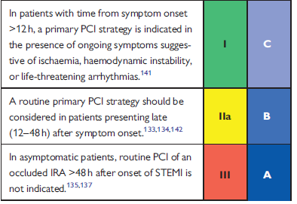

Slide 21
Occluded Artery TRIAL
NEJM DEC 2006
RCT
n-2166
stable patients
persistent occlusion of the IRA 3–28 days after MI
no clinical benefit from routine coronary intervention than with OMT

Slide 22
PRIMARY PCI
RADIAL approach—MATRIX TRIAL
8404 patients
30 days
Less bleeding
Vascular complications
Need for transfusion
RIVAL
RIFLE STEACS

Slide 25
STENTING—DES over BMS
Less need for repeated TVR
Decreased ST
COMFORTABLE AMI TRIAL

Slide 26
Deferred stenting—decreased MVO
DANAMI 3 DEFER TRIAL
1215 pts
RCT
42 months—no superiority over stent implantation
Thrombus aspiration
TOTAL TRIAL
NEJM APRIL 2015
10372 pts
Increased risk of stroke

Slide 27
TOTAL REVASCULARISATION
PRAMI TRIAL
CULPRIT TRIAL
Treatment of non IRA– decreased adverse CV events
IABP
CRISP AMI TRIAL
RCT
337 pts
No reduction in infarct size

Slide 28
PERIPROCEDURAL PHARMACOTHERAPY
DAPT+ P2Y12+ parentral AC
Aspirin-150-300mg
Clopidogrel-600mg
Prasugrel – 60mg LD f/b 10 mg OD
Ticagrelor-180mg LD f/b 90 mg BD
P and T—
Rapid onset of action
Greater potency

Slide 29
Prasugrel
C/I with
>75
<60kg
Stroke/TIA
Ticagrelor
Dyspnoea
No structural or functional abnormalities
Prasugrel and Ticagrelor
Not used in
Prior hemorrhages
On OAC
Mod –severe LD

Slide 30
Cangrelor
I/V p2y12
GP2B3A I
As bail out therapy
Large thrombus
Slow or no reflow
No role for intracoronary GP2B3AI

Slide 31
Parentral AC
UFH
Enoxaparin
Bivalirudin
No role for fondaparinaux –potential harm

Slide 32
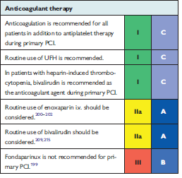
PERIPROCEDURAL PHARMACOTHERAPY

Slide 35
Routine post procedure AC not preferred
Except with
AF
LV thrombus
Mechanical valves
Prophylaxis of VTE

Slide 36
Major predictors of mortality—MVO and infarct size
MVO—inadequate perfusion after opening of IRA
Post procedure-TIMI <3
ST resolution post procedure <70%
Myocardial blush grade 0 or 1

Slide 38
FIBRINOLYSIS
Recommended within 12 hrs,if primary PCI cannot be done
If time exceeds >3hrs from symptom onset ,better primary PCI
No contraindications
Prehospital fibrinolysis
Metaanalysis (6 RCT)
N-6434
Decreases mortality -17%

Slide 39
STREAM trial
NEJM April 2013
RCT
1892 patients
Presented within 3hrs; unable to undergo prmary pci
TNK / PRIMARY PCI
PCI between 6-24 hrs
NO SIGNIFICANT DIFFERENCE BETWEEN PRIMARY ENDPOINTS
(death or reinfarction)
Increased risk of intracranial hemorrhages in fibrinolytic group

Slide 41
Fibrin specific agents preferred
Antiplatelets and Anticoagulation
No role for
Prasugrel
Ticagrelor
GP2B3A inhibitors

Slide 42
Parentral anticoagulation
Atleast 48 hrs
Or upto 8 days
ASSENT 3 TRIAL
TNK f/b enoxaparin OR UFH
RCT
6095 patients
decreased 30 day mortality/ MACE

Slide 45
CABG
In patients with
Patent IRA but with unsuitable anatomy for PCI
Cardiogenic shock
Large myocardium at jeopardy

Slide 46
AMBULATION
By day 1 ambulation begun
In patients with
Hypotension
Arrythmias
Heart failure
Once stabilized

Slide 47
Low risk patients- 48-72 hrs discharged
PAMI 11 CRITERIA
LOW RISK—
<70 yrs
LVEF >45%
1/2 vessel disease
Succesful PCI
No arrhythmias
ZWOLLE PRIMARY PCI INDEX

Slide 48
Special issues
Anticoagulation
OAC –relative C/I
Triaged for pci
Given
Aspirin
Clopidogrel
Avoid GP2B3A
Prasugrel / ticagrelor

Slide 49
Triple therapy
6 month
After 6 months– OAC+ A/C
After 1 year—OAC only

Slide 50
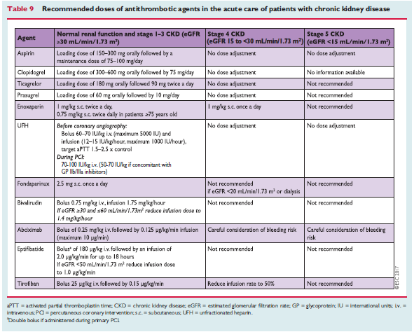
Renal dysfunction
Dose modification necessary
eGFR 30-40% worse prognosis

Slide 51
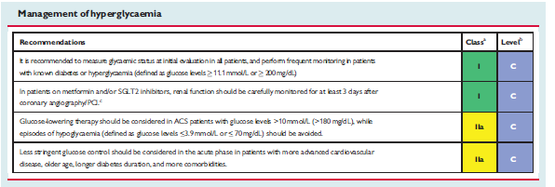
DIABETES
Causes diffuse atherosclerosis
BG < 200mg%
Measure e GFR –pts on metformin/SGLT2 inhibitors

Slide 52
Long term therapies
Smoking cessation
BP control
Encouraging physical activity
Smoking –
Strong prothrombotic effect
Most cost effective
Quitting decreases mortality-- metaanalysis --12603 patients(20 observational studies— decreases by 36%)
Behavioural support
Pharmacotherapies—buprorion , varenicline
Electronic cigarettes

Slide 53
Diet, alcohol and weight control
Meditteranean diet
Alcohol—2 glasses( 20g) daily for men and 1 for women
Maintain BMI < 25

Slide 54
Blood pressure control
<140mmHg
Elderly frail—more linient
Very high risk patients--<120mmHg
Exercise training—light to moderate physical activity
Cardiac rehabilitation–
Risk factor modification
Exercise training
Stress management
Psychological support

Slide 55
Adherence to treatment
Long term adherence—poor
50% adherence –several studies
To reduce poor adherence—FDC or polypill
FOCUS TRIAL -- FDC for secondary cardiovascular prevention trial
phase 2 trial
695 patients
9 months
Improved adherence

Slide 57
Antithrombotic therapy
Aspirin
Indefinetely
75-100mg
CURRENT OASIS 7 trial
Comparison to high dose
Similar antiischemic effects and less adverse effects

Slide 58
DAPT
Primary PCI
Aspirin
+
P2Y12 inhibitors
(clopidogrel/prasugrel/ticagrelor)
12 months

Slide 59
Fibrinolysis
Aspirin—lifelong
Clopidogrel-1 month
Fibrinolysis with subsequent PCI
DAPT -12 months
High bleeding risk—6 months

Slide 60
Extension of DAPT beyond 1 yr
DAPT study
NEJM Nov 2014—extending beyond 1 yr after DES
(multicentre randomized placebo controlled trial)
PEGASUS TIMI 54 study
NEJM May 2015
(compared ticagrelor 60 BD/90 BD vs placebo)
Both study showed decreased MACE
But with increased risk of bleeding

Slide 61
ATLAS ACS2 TIMI 51 TRIAL
( NEJM JAN 2012)
Low dose rivaroxaban 2.5mg 1—0—1
+
DAPT
13 months
Decrease short and long term mortality
Decreased MACE

Slide 62
Anti thrombotic therapy

Slide 64
Betablockers
Early beta blocker therpy
Decreases malignant ventricular arrhythmias
METOCARD CNIC trial
RCT
N-270
Early IV metoprolol
Killip 2 or less
Decreased infact size by CMR 5—7 days
Higher LVEF –6 months

Slide 65
EARLY BAMI trial
RCT
n-683
30 days follow up
No reduction of infarct size
Decreases malignant arrythmia

Slide 66
Long term therapy
Decreases mortality
Administered in pts without
Acute HF
Hemodynamic instability
Advanced HB

Slide 67
LIPID LOWERING
Following MI
Decreases TC/LDL/HDL
Increased TG
Intensive statins
Decreases non fatal MI/Stroke
LDL < 70mg%

Slide 68
PCSK 9 inhibitors
FOURIER trial
NEJM May 2017
RCT
N-27564
Mod—high intensity statins +/-evolocumab s/c
Decreases CV death
MACE

Slide 69
NITRATES
only to control residual angina symptoms
Early phase– HTN / heart failure
CALCIUM CHANNEL antagonists
C/I to beta blockers
Verapamil/diltiazem

Slide 70
ACEI/ARBs
Mortality benefit
AWMI
HTN
DM
LVEF < 40%
VALIANT trial—
Valsartan vs captopril
Non inferior

Slide 71
Aldosterone receptor antagonists
LVEF < 40%
Killip 2 and above
EPHESUS trial
RCT
6642 patients
16months
15% decreased mortality
13% decreased MACE

Slide 73
Thank u.

